Slide 1
350 parts

Slide 2
i-bank functional structure
technical modules
authentication
auditing
user profile
OTP functionality
e-mail notifications
push notifications
etc
business modules
deposits
cards
loans
bill payments
investments
transaction files
etc

Slide 3
i-bank code structure
15 technical modules
35 business modules
350 projects
240k lines

Slide 4
ALM
planning
deployment
defining
testing
designing
building

Slide 5
modular design
business area
business area
business area
planning
defining
planning
defining
planning
defining
designing
designing
designing
deployment
deployment
deployment
building
building
building
testing
testing
testing

Slide 6
modular design
day #1
customer
product
order
designing
designing
designing
deployment
deployment
deployment
building
building
building
testing
testing
testing
component (c# project)
component (c# project)
component (c# project)

Slide 7
modular design
day #2
customer
product
order
designing
designing
designing
deployment
deployment
deployment
building
building
building
testing
testing
testing
component (c# project)
component (c# project)
component (c# project)

Slide 8
circular reference
day #3
customer
product
order
designing
designing
designing
deployment
deployment
deployment
building
building
building
testing
testing
testing
component (c# project)
component (c# project)
component (c# project)

Slide 9
modular design
day #4
customer
product
order
designing
designing
designing
deployment
deployment
deployment
building
building
building
testing
testing
testing
component (c# project)
component (c# project)
component (c# project)

Slide 10
modular design
day #5
customer
product
order
designing
deployment
building
testing
component (c# project)

Slide 11
dependency resolution
customer
product
order
component (c# project)
component (c# project)
component (c# project)

Slide 12
modular design
rdbms
dependency
web service
dependency
customer
product
order
component publishing
component publishing
component publishing
c# projects
component implementation
component implementation
component implementation
implementation projects
component interface
component interface
component interface
component (folder)
component (folder)
component (folder)

Slide 13
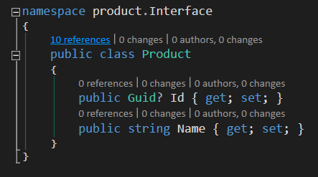
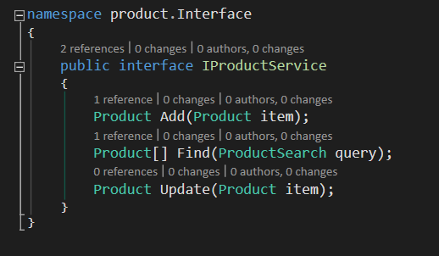
component interface
data contracts
service interfaces
very simple reusable methods
classes vs interfaces

Slide 14
invalid paths
customer
product
order
component publishing
component publishing
component publishing
c# projects
component implementation
component implementation
component implementation
component interface
component interface
component interface
component (folder)
component (folder)
component (folder)

Slide 15
valid paths
customer
product
order
component publishing
component publishing
component publishing
c# projects
component implementation
component implementation
component implementation
component interface
component interface
component interface
component (folder)
component (folder)
component (folder)

Slide 16
modular design
nuget packages
customer
product
order
component publishing
component publishing
component publishing
component implementation
component implementation
component implementation
component interface
component interface
component interface
component (folder)
component (folder)
component (folder)

Slide 17
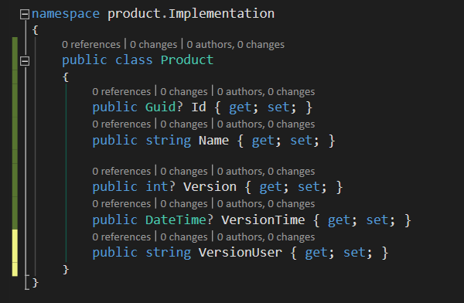
c# decoupling tools
extension methods
interface
implementation

Slide 18
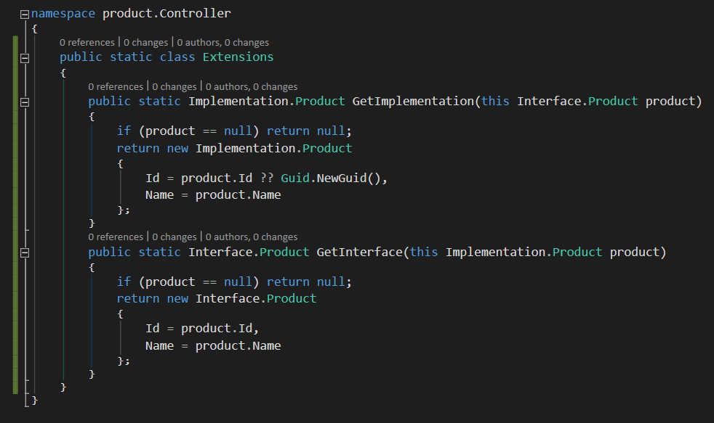
type mapping
c# decoupling tools
extension methods

Slide 19
dependency propagation
c# decoupling tools
dependency injection
component (c# project)
application
db connection
unit
unit
unit
configuration
logging
component (c# project)
unit
unit
unit
high level libraries
component (c# project)
low level libraries
low level libraries
unit
unit
unit
component (c# project)
component (c# project)
unit
unit
unit
unit
unit
unit

Slide 20
dependency resolution
c# decoupling tools
dependency injection
component (c# project)
application
factory
abstract factory
static factory
service locator
unit
unit
unit
configuration
component (c# project)
unit
unit
unit
high level libraries
component (c# project)
low level libraries
low level libraries
unit
unit
unit
component (c# project)
component (c# project)
unit
unit
unit
unit
unit
unit

Slide 21
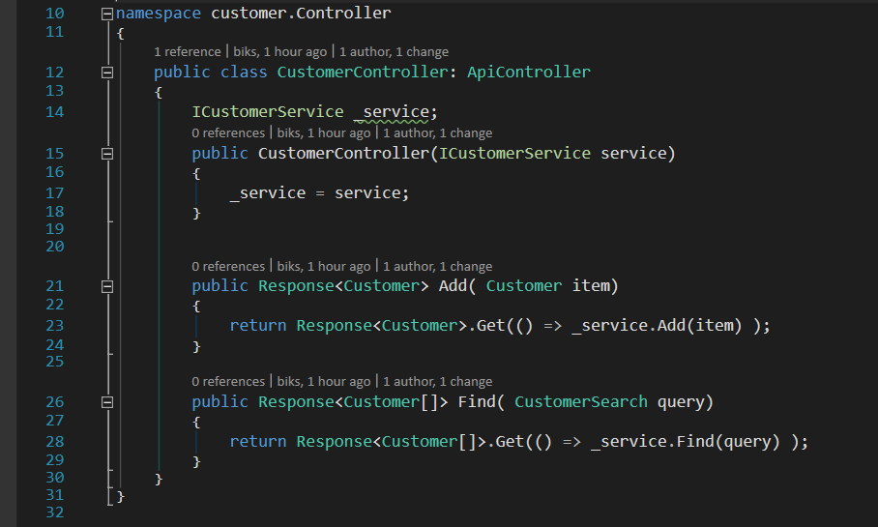
c# decoupling tools
dependency injection
controller constructor

Slide 22
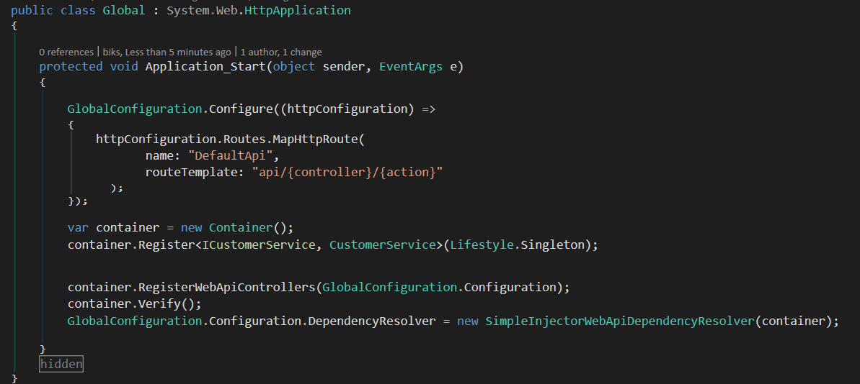
simple injector configuration
c# decoupling tools
dependency injection

Slide 23
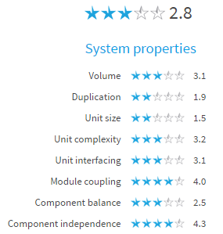
1st upload (Sept 2014)
255k lines
30% Duplicated Code (49k lines, 9.5k units)
11k C# lines 61+ LOC
2k C# lines McCabe 26+
1k C# lines > 4 Parameters

Slide 24
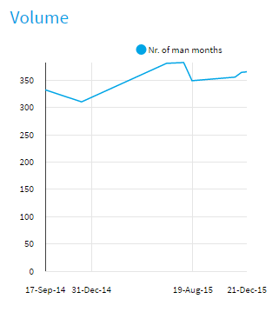
1st upload (Sept 2014)
255k lines
30% Duplicated Code (49k lines, 9.5k units)
11k C# lines 61+ LOC
2k C# lines McCabe 26+
1k C# lines > 4 Parameters

Slide 25
unit & module guidelines
unit: method, function
module: file, class, function
refactoring techniques
extract method
extract object
short units of code
up to 15 lines
simple units of code
up to 4 branch points
write code once
small unit interface
separate concerns in modules
small modules

Slide 26
module guidelines
loosely coupled components
small module interface
balanced number & size of top level components
small codebase

Slide 27
technology & tools
TypeScript
npm, bower, gulp, tsd, …
internal package repository (Nexus)
build automation (TFS)
maintainability tools (SonarLint)
maintainability monitoring (SIG, SonarQube)

