Slide 1
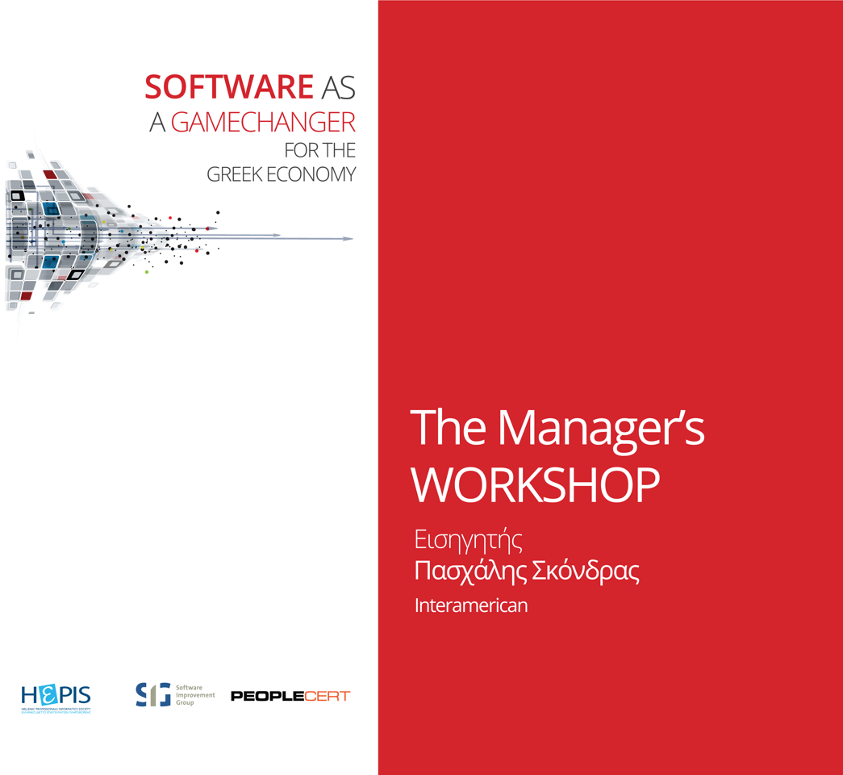

Slide 2
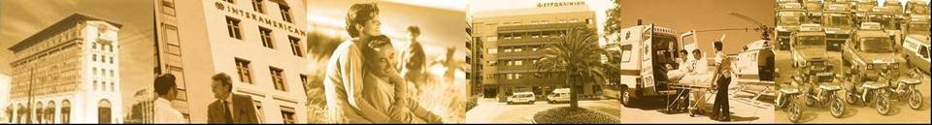
OnE Program
Athens, May 2016

Slide 3


Corporate Features
The most famous brand in Greek Insurance Market
The highest brand awareness (99%)
1nd position on P&C and Health lobs
2nd position, with a market share of 10,2%
  Profit: €42M
  GWP: €341M
The only insurer with its own
Health and Assistance infrastructure
Successful implementation of
multi distribution model
The 1st direct insurer in Greece through Anytime
Innovative products in Investments, Health, Assistance
Group employees
(58% men – 42% women):
  Insurance 755
  Assistance 350
  Clinics 174
1.100.000 unique customers:
  850.000 for INTERAMERICAN
  250.000 for Anytime
3

Slide 4

Our target is to become…
The most digital insurer in Europe by 2020
4

Slide 5

Time to evolve
IT systems
Business processes
Lean methodologies
5
Notes:
5

Slide 6
IT landscape before OnE
Sales MIS
STATS
AMS
ODS Commissions
Life
&
Health
Issuing
Life
&
Health
Admin
Group
Life &
P & C
Property
TPL
Motor
PAC
Crews
Legal
Protection
Claims
Legal
Protection
Issuing
SI Claims
Medi
Claims
Non
Medi
Claims
Claims Payments
General Ledger
6
More than 25 years
10 – 20 years
Less than 10 years

Slide 7
Project Unity
Perform a Make or Buy Analysis
2006 The selection process begun
Request for Information (RFI)
Request for Proposal (RFP)
Source selection criteria
2007 Project Unity was initiated
Increased costing – unable to deliver
Strong opposition by the business users to accept the new platform
2009 The project was stopped
Audits and Assessments by KPMG and SIG
BUY
Benefits:
Less resources needed
Yearly upgrades (maybe costly)
Programming code is written by specialists
Risks:
Vendor that fails to meet his obligations can be a big burden
Ambiguous time for the Internal staff to accept the system
Vendor may not know our business needs that well
BUILD
Benefits:
We decide exactly what we want and how we want it
No license fees and no maintenance fees to be paid
Risks:
Lack of internal skills to develop a modern system
Maintenance cost are higher
Longer implementation time => greater risk of failure
7

Slide 8



Project overview
The Business
TPL
Process Redesign
Product Restructuring
Reporting and Document Creation
Data Migration
IT Infrastructure
Interfaces and Operations
TPL
Property
Motor
Fire
Crews
Cars
Marine Cargo
Engineering
Crews
Gen. Accident
PAC
Leg. Protection
Aviation
Skafi
Yachts
The IT Department
Project Unity – “United We Stand !”
8
Notes:
Lisbon
24th June 2002
8

Slide 9
Lessons learned from project Unity
A number of lessons have been learnt during the course of the project, key actions resulting from the most important of these are as follows:
Sufficient, dedicated resources must be made available from both business and IT
  action: up-front, detailed resource plan and commitment from all parties
Improved communication both internally within the project as a whole and externally to the rest of Interamerican and Eureko
  action: development of a communication plan and approval of extra resources and budget for this
Dependencies on other projects and changes outside of the project are often not clearly known or understood
  action: creation of a change management plan, as well as regular communication with and appropriate participation in other projects – dependent or otherwise
9
Notes:
Lisbon
24th June 2002
9

Slide 10

What is OnE?
  OnE is a core insurance application that supports general insurance
  It was developed by Interamerican P&C as a replacement of six legacy applications
  The name OnE stands for Operations 'n' Excellence.
  The goal of the project was to provide a common platform for all insurance business operations.
10
Notes:
10

Slide 11

Facts and figures about OnE
  Code quality is controlled
  by SIG on a weekly basis
  OnE has been awarded the “Trusted Product Certificate”
  by TUVit
  Has an average rating of
  4 out of 5 stars
  Will support all lines of business of Interamerican P&C (>700.000 active policies)
11
Notes:
11

Slide 12

Main functional areas of OnE
  Product setup
  Policy administration
  Claims management and payments
  Reinsurance treaties
  Reinsurance allocation
12
Notes:
12

Slide 13
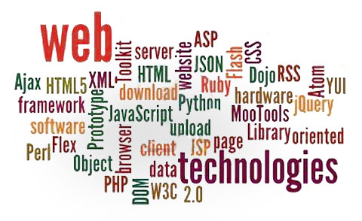
Expertise and Technologies in OnE
  Constant improvement
  Certification by PEOPLECERT on Quality Software Development
  Technology
  OnE is written with the java programming language
  The application is available via the HTTP protocol in a web browser
  The web layer utilizes the Apache Wicket framework
  The business layer is based on the Bo2 framework
  The data access layer is based on the Hibernate framework
  The data are stored in a relational database (IBM DB2)
  The application runs on a java application server. IBM WAS 8.x and Apache Geronimo 3.x are supported
13
Notes:
13

Slide 14
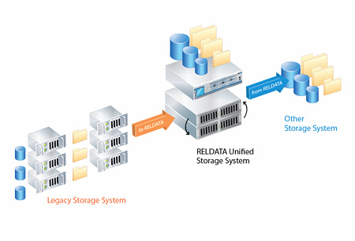
Migrate data from a legacy system
  The term data migration describes the process of loading to OnE transactions that have been issued by a legacy system. It produces functional data but usually there are limitations in functionality
  The term portfolio migration describes the process of batch issuing a new policy for each policy that were about to be renewed in the legacy system. Takes place on a monthly basis for a period of twelve months
  Migration strategy
  Which methodology will be followed
  Which data of the new system can be found in the legacy (data mapping)
  What data to migrate (active portfolio, all history)
  Functionality limitations of migrated data
14
Notes:
14

Slide 15
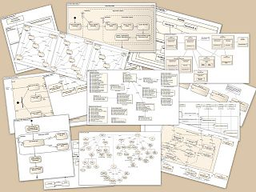

Wiki pages and documentation
  Plan pages
    Iteration plan contains list of issues planed for the iteration
    Issue contains links to the artifacts (use cases, flows, entities, etc) that are developed or modified
  System pages
    Use case contains description, actors and flows
    Flow consists of steps and could link to sub-flows
    Entity describes fields and relations with other entities
    Feature describes system functionality
    Glossary pages exist to explain technical insurance terms
15

Slide 16

Which variables define the system’s cost?
  Implementation Cost
  Required additions on core layer
  Size and complexity of company layer
  Number and complexity of products
  Ownership Cost
  Core maintenance
  Company layer maintenance
  Products maintenance
16
Notes:
16

Slide 17
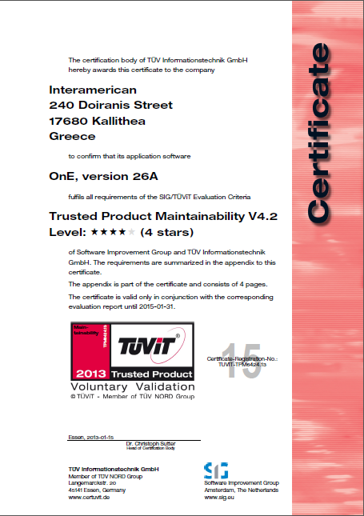
Some facts about the Certification
OnE is a 4 – star quality system
Maintainability score (4.0 star) remains on target despite the large volume of the system
Compared to other systems of similar size in SIG Benchmark (>700), OnE has the highest maintainability
OnE’s 4 – star quality leads to less development and less maintenance effort
13% lower costs of defects than average
Defect repair for the 4-star OnE is 1.5 times faster than a 3-star system
Developing a system of 3-star quality requires 1.5 times more effort than the 4-star
OnE is one of the best 4-star systems all over Europe that could be sold as an insurance package
17

Slide 18
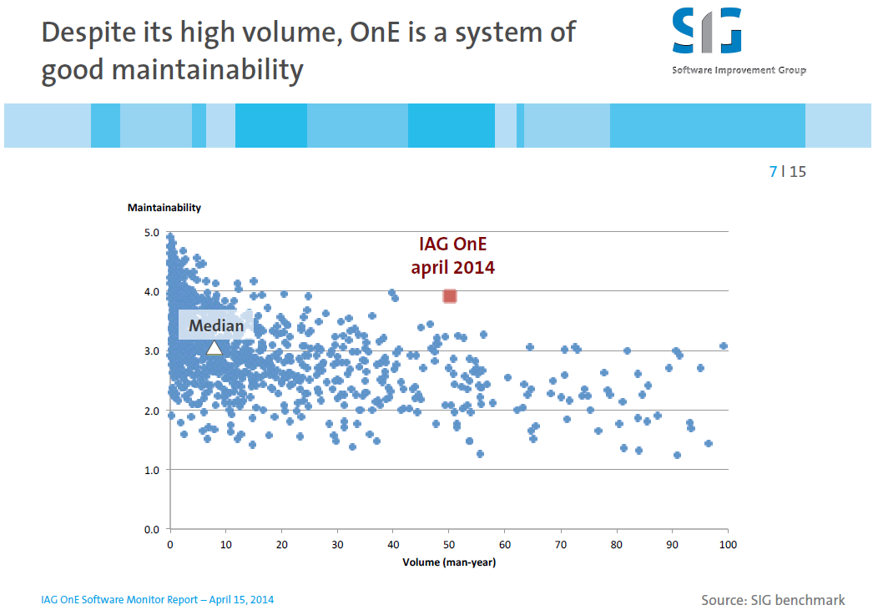
SIG’s recent findings
SIG remains more than positive about the achievements so far:
  Maintainability score (4.0 star) remains on target despite the large volume of the system
  Compared to other systems of similar size in SIG Benchmark
  (>700), OnE has the highest maintainability
18

Slide 19
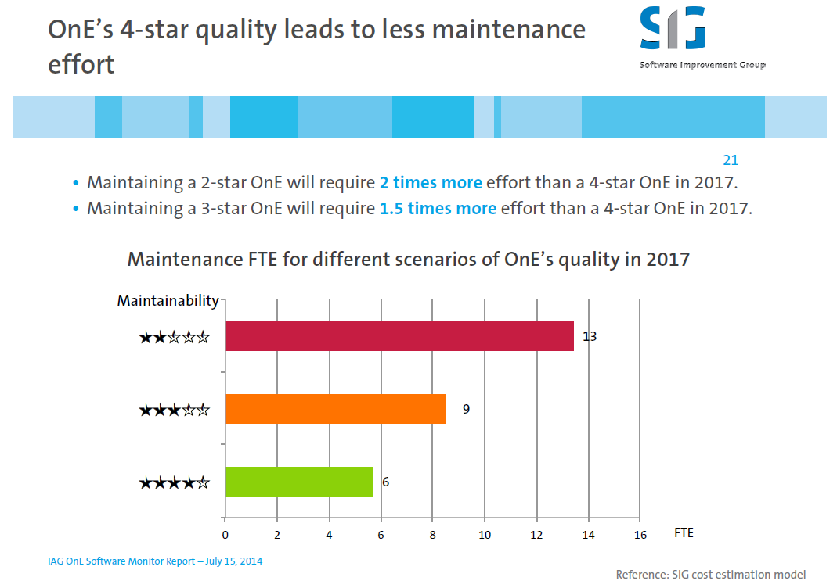
SIG’s recent findings
19

Slide 20
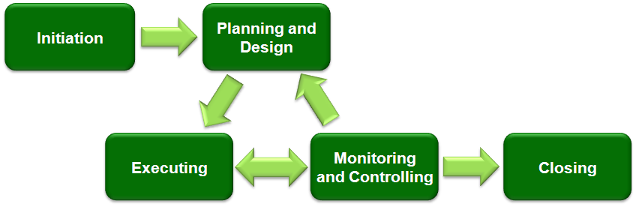
Adaptive life cycles (change-driven)
Various business constraints derived from daily operational activities
Imposed new functionality by management
Imposed legislative changes
Testing reveals unclear requirements or new functionality
Strong need for a CCB
20

Slide 21
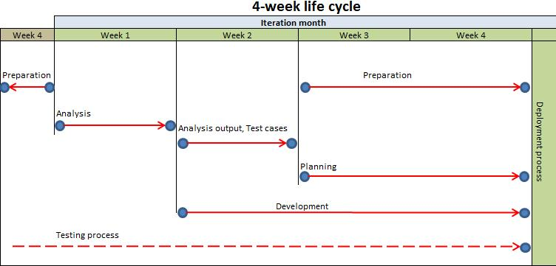
Iteration Life Cycle
  Monthly iterations
  One week of analysis, three weeks of development
  New version is deployed at the end of each iteration
  More than one streams can develop in parallel
  Testing is a continuous process
  Planning activities start as soon as analysis week is completed
21

Slide 22
Project Phases and Achievements
OnE is a 4 star system. The Project is divided into 3 phases.
Phase 1
Phase 2
Intermediate Phase
Phase 3
Go live with Property
Data migration of Property
Closure of property legacy system
Supporting production is a continuous process
  Train users and manage their roles
  Develop new functionality
  System stability and Bug fixing
  Pricing structures and templates
  Initiate planning activities for next phase
2010-2013
Go live with Motor
Go live with Yachts
Portfolio migration of Yachts
Anytime motor and home
Data migration of Motor
Closure of motor legacy system
Go live with all 5 PAC branches
Migration of PAC
Closure of PAC legacy system
R&H Assistance
Core 3
2013-2014
2014-2016
A great achievement is the composition of a team worthy of valuable results
22

Slide 23
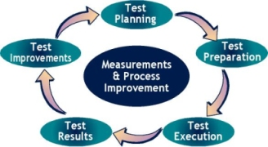
Testing and Quality Control
  Technical (developers)
  Unit tests (java)
  Integration tests (java)
  End to end tests (Selenium)
  Functional (Test team)
  Execute predefined user scenarios
  Automated tests (Silk)
  User acceptance tests
  Use of Jira
  Bug tracking tool
  Issues and change requests
  Report generator
Automated
23

Slide 24

Performance
  Performance tests with heavy workload simulation
    Web user interface
    Web services
  Profiling
  Monitoring UAT and Production environments
  Performance management process is monitored by SIG
24

Slide 25
OnE contribution on IT landscape transformation
Sales MIS
OnE
Sales MIS
STATS
STATS
AMS
AMS
OnE
OnE
OnE
OnE
ODS for Life& Health
ODS for Life& Health
ODS Prop.
ODS Prop.
ODS Prop.
ODS Prop.
ODS TPL
ODS TPL
ODS Motor
ODS Motor
ODS PAC
ODS PAC
ODS R.Ass.
OnE
ODS R.Ass.
OnE
OnE
OnE
OnE
G.L. for Property
G.L. for Property
Gen. Ledger for TPL
Gen. Ledger for TPL
Gen. Led. for Motor
G.L. for Group Life
Gen. Led. for Motor
G.L. for Group Life
Gen. Ledg. For R.Ass.
Gen. Ledger for PAC
Gen. Ledg. For R.Ass.
Gen. Ledger for PAC
Gen. Ledger for Life
OnE
Gen. Ledger for Life
Life
&
Health
Issuing
OnE
Motor
OnE
Life
&
Health
Issuing
Life
&
Health
Admin
Life
&
Health
Admin
Crews
Crews
Property
Property
TPL
TPL
Motor
Motor
PAC
OnE
OnE
OnE
PAC
R&H
Legal
Protection
Claims
Legal
Protection
Claims
Legal
Protection
Issuing
OnE
OnE
OnE
Group
Life &
P & C
Group
Life &
P & C
Group
Life &
P & C
OnE
SI Claims
SI Claims
SI Claims
Medi
Claims
OnE
Medi
Claims
Non
Medi
Claims
Medi
Claims
Non
Medi
Claims
Non
Medi
Claims
Group Life
Claims
Group Life
Claims
Claims Payments
Claims Payments
Group Life
Claims
Claims Payments
Completed
25
Q3 2016

Slide 26
Vision – Become even more Agile
Adaptive life cycles approach
Project
Project Manager
Project Management plans, Iteration plans, Document updates, Performance measurements against baselines, Reporting
Team A
Team B
Team C
Team D
Team Leader
Team Leader
Team Leader
Team Leader
Analyst
Tester
Analyst
Tester
Analyst
Tester
Analyst
Tester
4 x Programmers
4 x Programmers
4 x Programmers
4 x Programmers
Analysis, Code, Bugs, Reporting
Analysis, Code, Bugs, Reporting
Analysis, Code, Bugs, Reporting
Analysis, Code, Bugs, Reporting
26

Slide 27
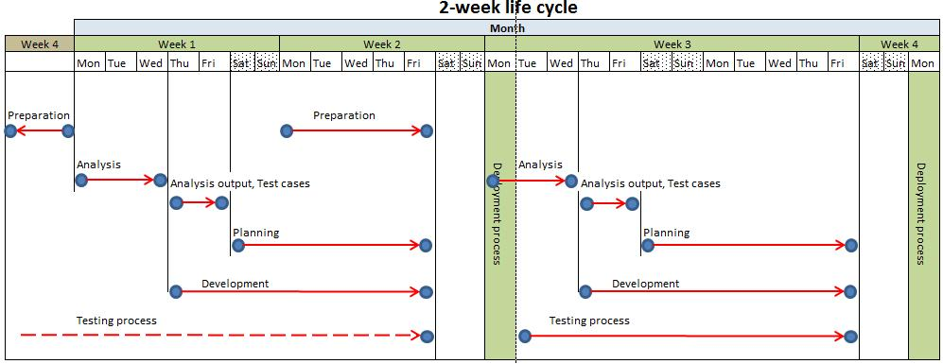
Vision – Smaller iteration Life Cycle
  A 2-week iteration
  3 days of analysis, 7 days of development
  Benefits
  Less requirements, easier to digest
  Less functionality, less development time
  Easier to plan and to control
  Easier to stay focused
  Easier to foresee and analyze risks
  Easier to test
  Risks
  Less time to deploy
  Very tight schedules
  More stressful for people (until they get used to it)
27

Slide 28
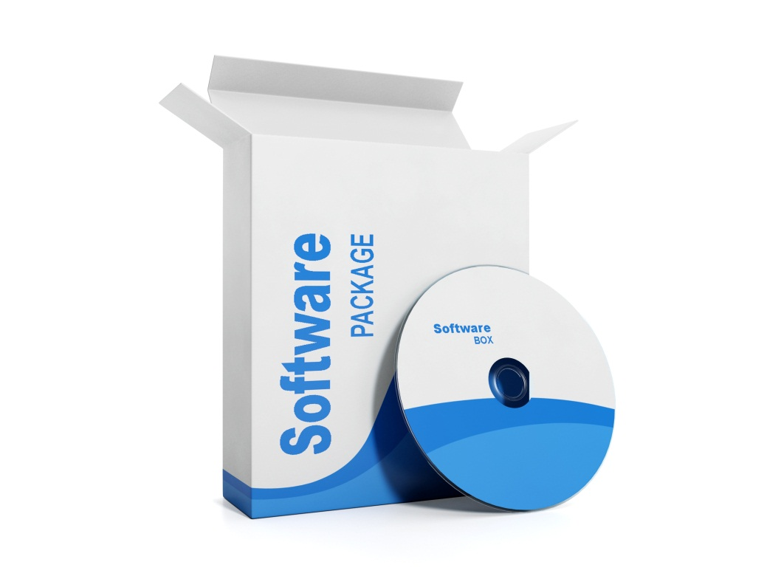
Vision - Commercial Software Package
Off the shelf / Packaged systems
Mainly European market
Standardization of business process
28

Slide 29
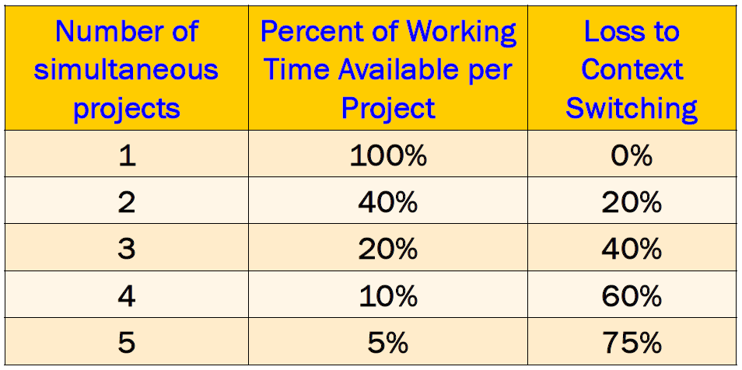
Clifford Nass
A Stanford University professor and a pioneer multitasking researcher
He showed how counter productive multitasking is
Studies have shown that switching from one project to another in quick succession can seriously hurt your velocity
In many companies teams are often assigned more than one project at a time
This forces them to switch between projects rather than focusing on just one, finish it and then move to the next
If you multitask at ten projects, it’s like reading ten books simultaneously one page at a time
29

Slide 30

Thank you for your attention
Paschalis Skondras
skondrasp@interamerican.gr

