Slide 1
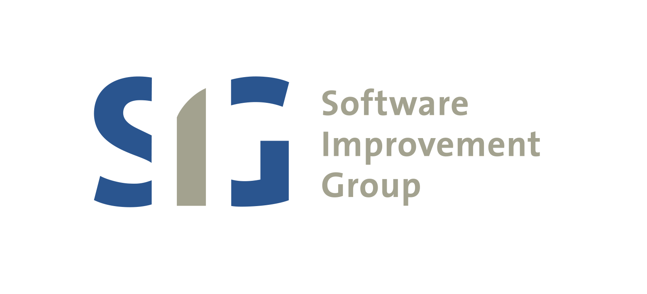

The Global Software Development Meltdown And three business models to fix it
Tobias Kuipers
GETTING SOFTWARE RIGHT

Slide 2
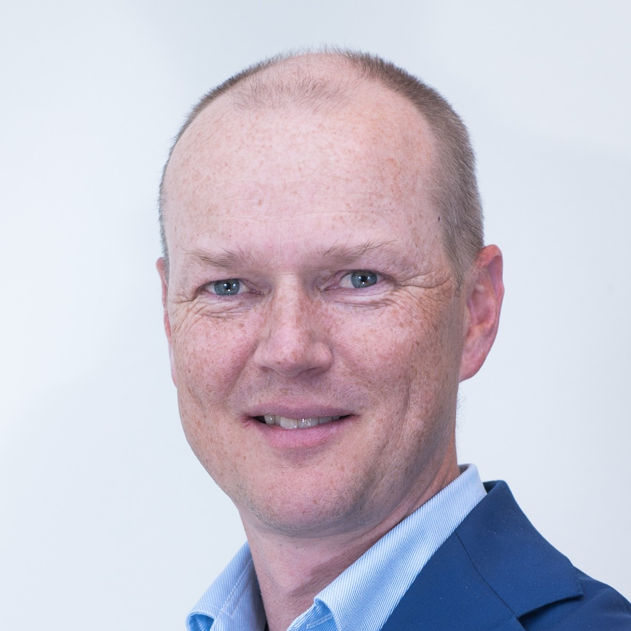
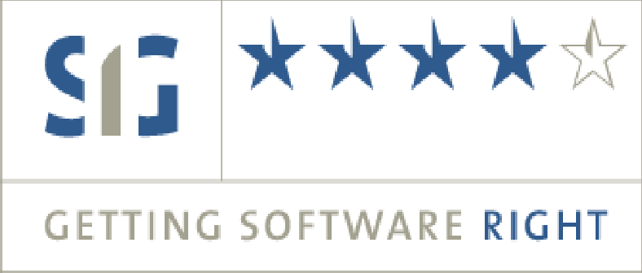
First things first
Tobias Kuipers
Founder of SIG
Started and ran SIG for 15 years
Currently advisor to SIG board
Working on various new initiatives
Mentoring high tech start ups
Software Improvement Group
IT Management Advisory and Measurement Lab
ISO 25010 software product inspections
ISO 17025 lab analyses 25 million lines of code each week
•
Translate technical findings into actionable recommendations

Slide 3
15 years of Software Economics
> Consulting on questions like...
How much should our IT department be spending on software development?
How many people should we employ in software development?
How can we stop the growth of our software budget?
• (After 2007)
We are quoted a price of X million for a project, is that fair/cheap/ expensive?
> Has led to a number of statistical insights...

Slide 4
Numbers we’ve learned
> Lines of code
Unit of programming
10,000 per year per developer, on average
Large variance
> Maintenance
Given an existing solution, number of changes needed to keep it working
15% of lines of code per year (completely stable number)
Systems grow by 15% per year
Number of developers does NOT grow by 15% per year

Slide 5
There is a progressively growing need for software developers
Millions
30
25
20
15
Projected worldwide developers Needed to do all maintenance
10
5
0
2016
2017
2018
2019
2020
2021

Slide 6
Or at some point we will all be working on maintenance only
Millions
25
20
15
Total Developers
Developers working on Maintenance
10
5
0
2016 2017 2018 2019 2020 2021 2022 2023 2024 2025 2026 2027 2028

Slide 7
Solutions to the problem, corporate view
> Make software developers cheaper
Move them to a lower cost country
> Have less software
Outsource software development, becomes someone else’s problem
  Or does it?
Use standard software, no maintenance required, only a license
  But does that work for non-standard situations?
> Actively manage the amount of maintenance
High quality software still needs 15% maintenance, but is 15% changed, not added.

Slide 8
Solutions, societal view
> Making developers cheaper does not help
We need to stop the exponential growth. There aren’t enough people, cheap or otherwise
> There is a clear need for many many many more software developers
Make sure they learn about Maintainability and are PeopleCert/SIG certified
> We need ways to have less software.
Software industry is where car industry was 40 years ago
Everything is made to measure, there is no quality control
Now, standard components everywhere, there are no bad cars

Slide 9
So, three business models
1 Training - Easy
> There is an enormous need for software developers
> Take people from all over Europe who have no formal training in Software, but have a knack for it
(Let them do an entry test)
> Fly them to Greece
> In 12 weeks, learn them how to program
> Charge them €25000 each
> (these numbers can be modified ☺☺)
> In the US, this already works (w/out the flying to Greece part)

Slide 10
2 Services/components - Less Easy
> Taking cues from the car industry
Start developing standard services that can be used in other systems
> This is a market that is taking off enormously
> From small/technical
Payments (handling of local payment methods for e-commerce)
Ticketing (for events)
Image manipulation (always have the right resolution image for any device)
Authentication (log-in services)
> To full service
Salesforce
Intralot

Slide 11
3 Software technology - Hard
> Create software development technology that needs less maintenance
> As cars became better, they required less and less maintenance
(to the point where it is now basically zero)
> The 15% we observed is mostly technical, not functional
> Create a technology that would not require the technical changes (or would do the technical changes automatically) so that the workforce can focus on the functional changes
> This requires actual new research

Slide 12
Wrap up
> If we don’t do anything, all software developers will be working exclusively on maintenance
> Three business models to fix it
Intensive expensive training of software developers
Create standard components as a service for other software developers
Build software technology that requires less maintenance
> Contact me if you would like to discuss further
Tobias Kuipers
tobias.kuipers@gmail.com
@tobiaskuipers
• +31614488847

